Slide 1
Pokhara University
GANDAKI COLLEGE OF ENGINEERING & SCIENCE
Lamachaur, Pokhara
GUI PAINT BOX
Developed & Designed By:
B. K. Krishna Magar
Ghan Bahadur Thapa
Mukesh Bhattarai
Sushil Ale Magar
Sushil G. C.
Sushil Timilsina
Supervisor
Mr. Ram Chandra Acharya
30th March, 2012

Slide 2
INTRODUCTION
FEATURES
graphical user interface
use mouse in selected draw area
draw general figures
use different colors
exit program using close button

Slide 3
WORK DIVISION
NAMES
B. K. Krishna Magar
Ghan Bahadur Thapa
Mukesh Bhattarai
Sushil Ale Magar
Sushil G. C.
Sushil Timilsina
ASSOCIATED SECTORS
Ellipse, Circle & Documentation
Info Module & Slides Design
Documentation & Slides Design
Menu Design, Unit Testing & compiling
Rectangle, Line & Debugging
Material Collection

Slide 4
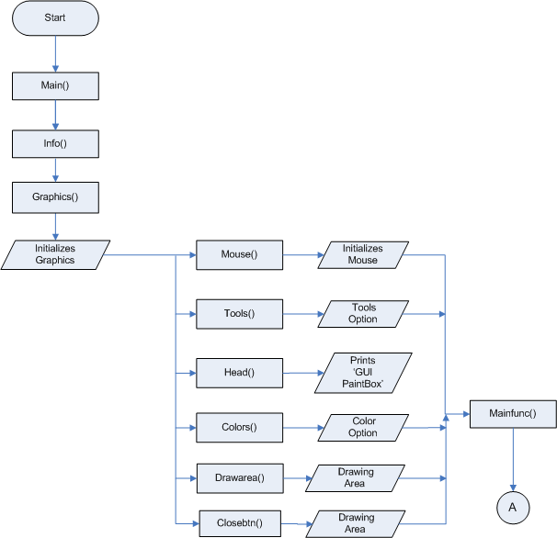
FLOWCHART

Slide 5
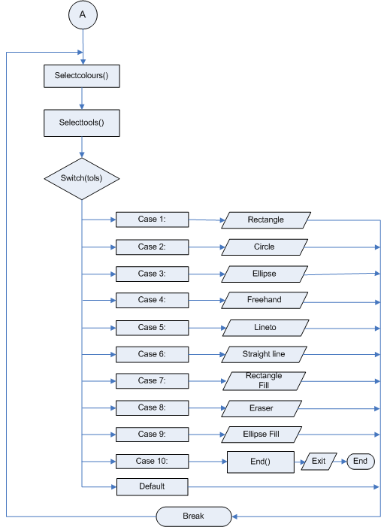
FLOWCHART

Slide 6
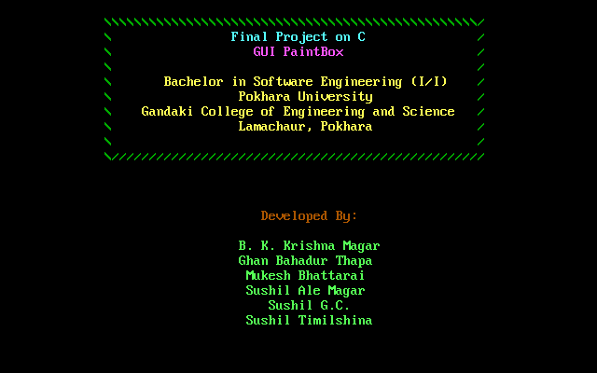
SNAPSHOTS
WELCOME WINDOW

Slide 7
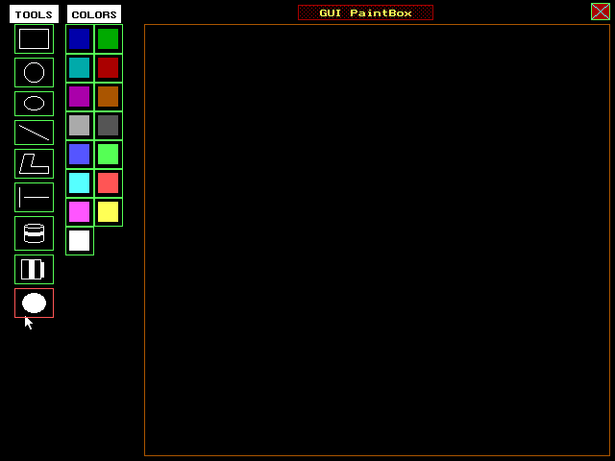
SNAPSHOTS
MAIN MENU WINDOW
Tools Panel
Color Panel
Title
Drawing area
Exit
Rectangle
Circle
Ellipse
Freehand
Lineto
Line
Rectangle Fill
Eraser
Ellipse/Circle Fill
Cursor

Slide 8
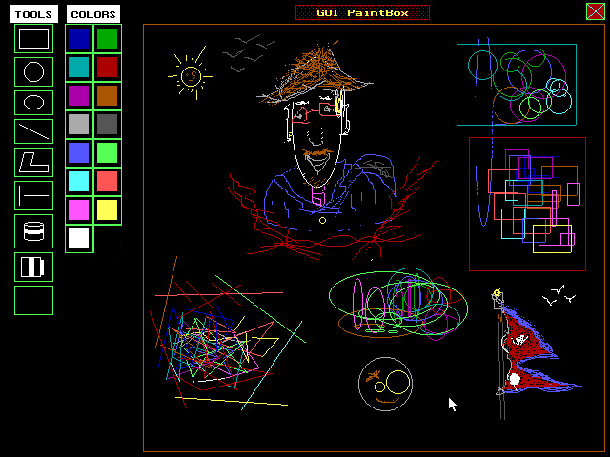
SNAPSHOTS
SAMPLE DRAWING
Art Credit: Sushil Ale Magar

Slide 9
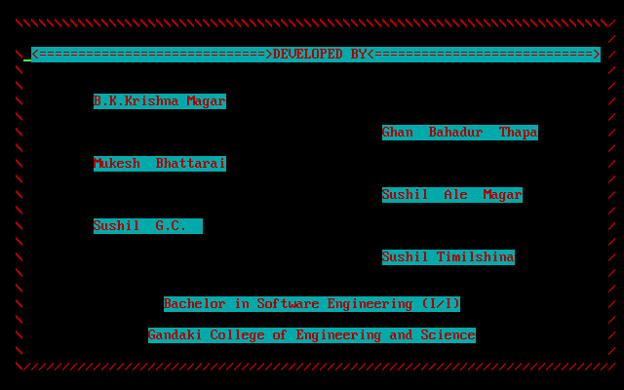
SNAPSHOTS
CLOSING WINDOW

Slide 10
LIMITATIONS
Text
Save
Edit
Difficult to erase

Slide 11
EXPERIENCES
Revision of knowledge gained from lectures
Comprehensive use of graphic functions
Mouse handling and use them for interface
Managing project
Debugging syntactical and logical errors
Unit testing and compiling modules
Managing modules while compiling

Slide 12
THE BOTTOM LINE
The project is an effort to reflect our C-programming skills developed during the 1st Semester.
The program will go through thorough improvement on its limitations and additional features for the time to come.
We would like to thank all the teaching staffs and our colleagues for their sincere comments and advices during the developing phase.

